Slide 1

Data, Evaluation, & Policy at a Nonprofit Research Organization
Theresa Anderson
July 19, 2023

Slide 2
Hello
I get 0 points for an interesting title, but this presentation is going to be a
STORY
of data, research, policy, & a career track through them

Slide 3
Starting with the data & research
The middle
Setting the scene: I was in a PhD program at George Washington University (while working full time)
Working on my dissertation on women who go back to school after having kids: student mothers
  How do they fare in the long run?
  What about their kids?
  What are their experiences?
Notes:
Which is the middle of this story

Slide 4
Because I can’t resist…Who are student-mothers?
2.6 million
Notes:
I’m going to take 10 minutes to get into this research before I continue my story. I hope you fin it as interesting as I do.
First, a bit of background:
You might be surprised to learn that more than one in five (22%) undergraduate college students are parents, & **CLICK** more than one in four (28%) female undergraduate college students are parents.
**CLICK** This adds up to 2.6 million undergraduate student-mothers in 2016
Also, more than one-third (34%) of all women with children enroll in school at some point with minor kids
**CLICK** 40% of all Black female undergrads were mothers in 2016, & more than half (51%) of Black mothers enroll in school at some point
43% of all Black children saw their mother in school when they were minors
Promoting student-parent success is promoting the success of students of color
Not all are single moms: **CLICK** More than one third (38%) of undergrad student-mothers were married in 2016
We know from other work & from talking with many parenting students that student-parents are motivated to succeed so they can set a good example for their children & better support their families. They also earn equal or higher grades than other students.
But that said, they are more likely to have low incomes & work while in school, be enrolled part time, & not complete a degree (especially if they are unmarried). Student-parents have to navigate systems & balance school, children, (often) employment, & other life responsibilities. While doing all of that, student-parents rarely receive appropriate advising, struggle to afford tuition & costs considering their other financial obligations, & often lack social supports while in school.
Also, if needed:
26% of white & Latina female students were mothers in 2016
30% of white mothers enroll in school, & 41% of Latina mothers

Slide 5
The research
The middle
Examined national survey data from 1979-2014 for women & their children
Interviewed 20 women in two-year college, four-year college, & graduate school programs
Looked at academic, economic, & social wellbeing

Slide 6
A few data considerations
Survey was of women in the US in 1979 & were born 1957-1964
  Largely went back to school in the late 1980s & early 1990s
  Does not reflect more recent immigrant groups or current college/labor market contexts
Children are biological children of women in the survey sample
Qualitative insights come from a 20-person sample in the national capital area interviewed in fall 2018
Notes:
I want to briefly mention a few considerations before I get into the results & findings.
The survey I used covered a specific group – women who were in the US in 1979 & were born from1957-1964, & their biological children. These women largely went back to school in the late 1980s & early 1990s, so these findings don’t reflect some recent changes, including more recent immigrant groups & changes in college costs & the labor market in the last few decades.
The interviews were conducted in a specific time & place—fall 2018 in the national capital area. It’s not a random sample meant to be representative of any larger group. So I don’t want to generalize too broadly, though there were a lot of consistent themes & recommendations in these women’s experiences which are important, & others have echoed in research in other places & populations.

Slide 7
Findings
Notes:
So that said, here is what I found.

Slide 8
Mothers’ educational growth is gradual
1/3 of student-mothers complete a higher credential eventually
Less than 1/4 of mothers who did not have college degrees completed one
Notes:
This graph shows the growth in educational attainment for the mothers who reenrolled in school relative to very similar mothers who did not reenroll for the 20 years after mothers first returned to school. The numbers on the bottom show the number of years since the mothers first reenrolled in school. The green line shows high school diplomas, the blue line shows college degrees, the red line shows four-year degrees, which is a subset of college degrees. & the pink line shows graduate degrees. The main takeaway is that mothers who went back to school didn’t get their credentials & degrees right away. In fact, some women were still getting their degrees 10, 15, 20 years after they first went back. This is not a one-and-done experience, which shouldn’t be a surprise to those on this webinar.
**CLICK** That said, only one-third of mothers who went back got the next-highest-level credential eventually. & only one-quarter who did not have a college degree completed one – either a two-year or four-year degree. I’m going to show findings for mothers & their children overall – meaning if they enrolled at all, regardless of completion – & also for mothers & their children where mothers completed a college degree & didn’t have one before.

Slide 9
Findings for mothers
 | Any Reenrollment | Completed College Degree
Earnings | $2,072 average earnings gain per year | $6,776 average earnings gain per year
Opportunity costs | Earnings losses for 5 years Earnings not consistently significantly higher until 9 years after reenrollment | Similar timeframe, but the gains were larger once they were positive
Household income | $5,243 decline in household income per year | No decline in household income
Marriage | Married for two fewer years Less likely to be married in all 16 years after reenrollment | Similar patterns
Depression | Higher depression scores at age 50 | No higher depression scores
Notes:
Let’s talk about the mothers first.
**CLICK** Going back to school resulted in earnings gains for women overall of about $2000 per year, & the gains were over three times higher on average if they completed a college degree.
**CLICK** But there were what we call “opportunity costs” – that is, earnings were lower for a while when they were pursuing their education. They had lower earnings for about 5 years, & the gains were not consistent & statistically significant until 9 years after they went back to school. The opportunity costs of education were not accidental; many women shared in interviews that they made explicit decisions to decrease their work effort & earnings to accommodate their schooling & try to retain some time with their children. They recognized these income losses as part of the cost of education, but they anticipated the tradeoff would pay off financially in the long run.
**CLICK** Even though earnings were higher, household income actually declined for the overall group, though not for those who completed college.
**CLICK** This is related to an interesting pattern around marriage. Across both groups, mothers who went back to school were less likely to be married – this was a very consistent finding over time. This means there were less likely to be two earners in the household. There are three possible explanations for this marriage pattern, each of which found some support in the qualitative research: (1) some women returned to school during or following a separation or divorce, (2) school reentry put pressure on some relationships, & (3) women who were not married at reentry were less likely to subsequently marry. In the qualitative interviews, some mothers explained that they decided to return to school shortly after the failure of a marriage or relationship; others said the stress & pressure of their schooling put new demands on continued partnerships. In addition, some women said they found they developed new self-identities through their education that clashed with their husbands’ ideas about family roles. These various dynamics show that causality is muddled. Therefore, it would not be accurate to say that school reenrollment causes marriage rates to decline, but there is an understandable association. The qualitative research gave less perspective on whether unpartnered mothers who increased their education were less likely to find a marriageable partner in the longer term, but the quantitative results show negative marriage effects even for mothers who were not living with spouses or partners in the year of reenrollment. But women who increase their educational attainment while they are unmarried after having children may have more difficulty finding well-matched partners, or they may be less likely to marry as they gain more financial & personal independence.
**CLICK** Finally, mothers overall had higher depression scores at age 50, though we didn’t see that among mothers who completed a college degree. **CLICK**

Slide 10
Findings for children
 | Mother Reenrolled at All | Mother Completed College Degree
Short-term test scores | Gains in verbal scores for 2 year Gains in reading schools for a year | Larger gains in verbal scores Gains in reading scores for 4 years
Behavior | Worse behavior scores for 5 years | No worse behavior scores, but higher rates of suspension
Education | 2% more likely to complete high school 10% more likely to enroll in college 16% more likely to get a college degree | 9% more likely to complete high school 21% more likely to enroll in college 38% more likely to get a college degree
Earnings after age 25 | No earnings gain | $4,096 average earnings gain per year
Marriage | No effects on marriage | No effects on marriage
Health | 19% more likely to have a serious physical health limitation No differences in depression | No worse health No differences in depression
Notes:
Looking at the children…
**CLICK** the short term, children gained on their verbal & reading test scores when their mothers reenrolled in school. These gains were larger & lasted longer for children whose mothers completed a college degree.
**CLICK** But they also had worst behavior indicators. In the overall group, this was measured as a standardized behavior problem index, which was worst for children whose mothers went abck to school for five years. Among children whose mothers completed a degree, their behavior scores were actually not worse, but they were more likely to be suspended at some point in school. These findings suggest transition costs of mothers’ educational enrollment for children may exist, though some benefits appear as well. The persistence of negative behavioral effects suggests there may be a slippery slope: once children begin to have behavioral problems, they persist. However, it is important to note that the behavioral scores were based on mothers’ reports of their children’s behavior on various scales. It is also possible that mothers’ expectations for children increased as the mothers gained more education, resulting in worse behavioral assessment scores.
Interviewees from my qualitative research expressed concerns about the quality & quantity of time they could spend with children while they were in school. The qualitative interviews provided some suggestive support for two explanations. First, children may have had more unsupervised time or have been in lower-quality care environments while their mothers were in school. Second, children may have perceived they were not their mothers’ top priority as the mothers struggled to make multiple ends meet.
**CLICK** Children of mothers who reenrolled in school saw higher educational attainment themselves. They were 2% more likely to complete high school, 10% more likely to enroll in college, & 16% more likely to get a college degree. Among children whose mothers completed college degrees, these rates were even higher – for example, they were almost 40% more likely to get a college degree themselves.
**CLICK** Children in the overall group did not see gains in their earnings in early adulthood, but those whose mothers competed degrees did see increases in earnings of about $4000 per year after age 25. The children were age 28 on average in the last year of analysis, though the oldest children were in their early forties.
**CLICK** Despite the negative effects on mothers’ marriages, there were no significant effects on children’s probability of getting married or number of years married overall.
**CLICK** & finally, we saw some negative effects on children’s physical health in the overall group, but no effects for the children of college completers & no differences in depression for either group. **CLICK**

Slide 11
Overall summary
Mothers who reenroll gain more education, work more, & earn more on average, but they are less likely to be married & family income declines
  Some long-term negative mental health effects
Children of mothers who reenroll do better academically in the short & long term on average, but this only translates into earnings gains for children of mothers who completed college degrees
  Children also experience more behavioral problems
Enrollment is hard on families, but mothers think it is worthwhile to meet their employment & personal goals & set a good example for their children
  Express they could use more supports
Notes:
Overall – (summarize slide)

Slide 12
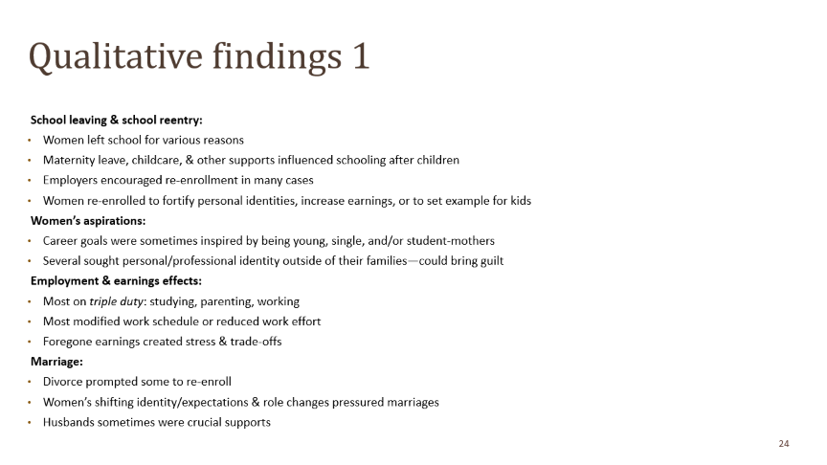
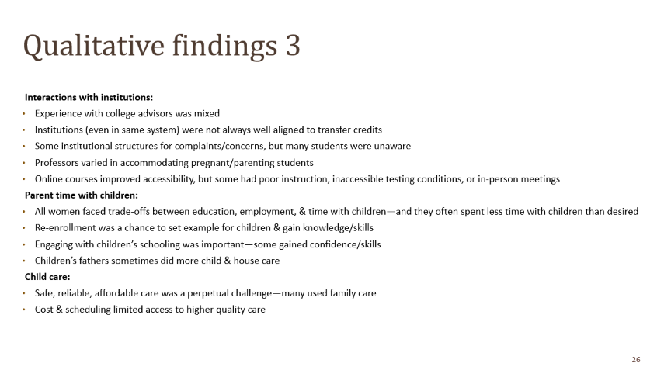
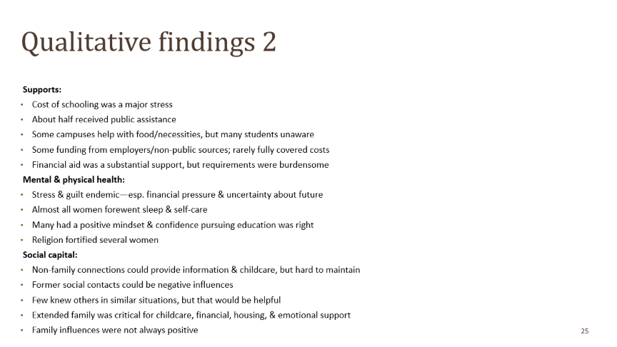
Summary of qualitative findings
Many made explicit decisions to decrease work effort/ earnings to accommodate schooling & retain time with children
Some decided to return to school shortly after marriage/ relationship failure; for others, stress & pressure of schooling and/or new self identities challenged continued partnerships
Mental health challenges & immense stress while in school
Some discussion of positive role-modeling & concerted cultivation of children
Qualitative findings do not explain well children’s negative behavioral issues
Notes:
Qualitative data provide rich detail about the perspectives & experiences of mothers pursuing education. I have a lot of findings from this portion of the research, but I summarize here the ones most closely related to the quantitative findings.
Many women made explicit decisions to decrease their work effort & earnings to accommodate schooling & retain some time with children. They considered this part of the cost of education & anticipated it would pay off financially in the long run.
Sometimes women decided to return to school shortly after marriage or relationship failure, but sometimes stress & pressure of schooling and/or new self identities challenged continued partnerships. It would not be accurate to say that school reenrollment causes marriage rates to decline, but there is an understandable association.
Women experienced mental health challenges & immense stress while in school, & support was often informal through family, partners, & friends.
Some women discussed positive role-modeling & “concerted cultivation” of children, which might point toward better child outcomes. But the qualitative findings do not explain well children’s negative behavioral issues. Unfortunately, because I talked with mothers but not with children themselves, it was more difficult to figure out what might be driving this result.
From anecdotal feedback from others whom I’ve talked with about this finding, it is possible that reduced attention from mothers, lower-quality care situations, and/or being considered a lower priority during children’s important formative years leads to behavioral instability. But I believe further investigation would be necessary to fully disentangle this issue.
Given the positive themes around child development in the qualitative work & the positive effects on education outcomes discovered in the quantitative analysis, it is surprising that I do not observe positive impacts on children’s longer-term employment & earnings. That said, it is possible that positive effects had yet to manifest. It is also possible that “stickiness” in intergenerational mobility takes more to overcome than parents’ delayed additional educational attainment. This is another area that would benefit from further investigation, perhaps through interviews with people who had parents who returned to school & could reflect on how it affected their trajectories.

Slide 13
Policy wheels while parents are enrolled:
Campus culture & advising
Safe & welcoming campus culture
Family-Friendly Campus Toolkit
Adapt "8 Keys to Veterans’ Success"
Reasonable accom-modations point person
Colleges study student-parent population
Advising support
Holistic advising
Student-parent-specific advising
Notes:
Based on the recommendations and insights from this work, as well as a general review of policy issues, I look at ways to improve experiences for student-mothers while enrolled. Of course, this was developed before COVID, but I think the themes persist, even if the execution may have to be modified.
I identify five areas that would make a big difference for parents, summarized on this & the next slides.
**CLICK** The first is a safe & welcoming campus culture. In my research write-up, I share recommendations from the interviewees about how to achieve this, many of which are low- or no cost. Some tangible suggestions I can offer is that institutions look into using the Family-friendly Campus Toolkit from PERG Learning, which focuses on helping institutions assess how they can help students meet basic needs, build community, & obtain funding.
They might also look at the 8 Keys to Veterans’ Success, identified by the Obama Administration, but which can easily be adapted to parenting students.
One interesting suggestion from the interviews is that colleges identify a point person student-parents can use to request reasonable accommodations, similar to structures that already exist for students with disabilities & veterans—and athletes at some schools.
Finally, colleges would be able to address issues on campus better if they understood the size & characteristics of their student-parent populations. Data and measurement challenges and limitations on disaggregating student data by parenting status are issues at the college level. (We’re actually working on a project about this right now.)
**CLICK** Another area that would help students is strengthening advising supports. This may involve enhancing college advising to look beyond academic issues & support holistic needs and/or instituting student-parent specific advising. Schools can implement advising specific to parenting students, or at least explicitly train all advisors on common issues student-parents face, such as child care, which is an advising oversight highlighted by the US Government Accountability Office. This may also include helping direct parenting students to programs they are likely to complete because the programs are suited to their schedule and interests. They can also emphasize programs that might lead to high labor market payoffs by preparing students for high-demand and high-wage jobs or having good connections with quality employment opportunities. Directing students to programs in which they are likely to succeed academically and economically can improve family outcomes in the long term.

Slide 14
Policy wheels while parents are enrolled:
Child care & financial support
Child care
Extended, weekend, non-traditional
CCDF covers education support activities
Expand on-campus child care
More subsidies & providers
Include cost of care in financial aid
Financial support
Financial aid & Pell changes
WIOA consis-tency
More refundable tax benefits for low-wage workers
Access to SNAP, TANF, Medicaid, & housing
Notes:
**CLICK** Child care is a major area of focus for this population, but interventions are often costly. Several child care support options exist for student-parents, though none fully addresses the need. The first is increasing the number of subsidies and providers overall. In addition, more support to cover the cost of care during extended, nontraditional, & weekend hours would help student-parents, who are often also working. An expansion of on-campus child care options would be obviously beneficial. Recently, CCAMPIS received an infusion of funding to do just that, though the results are not yet known. If states took advantage of flexibilities allowed by the Child Care Development Fund to provide care during education support activities—like homework & education-related activities—instead of only counting hours in class or work as eligible, that would allow student-parents to be more successful. Finally, federal policy can address how to increase dependent care allowances as part of financial aid to fully account for the cost of child care, as well as other family-related costs necessary for educational progress.
**CLICK** Another big area is financial support. An issue commonly raised in the interviews & the literature is financial aid & the Pell grant program. This is the primary tuition support for student-parents, but the way income protection is calculated, certain Pell Grant restrictions, & the calculations of allowances penalize working student-parents. In addition, this population, like many others, would benefit from simplification of the FAFSA/aid application process & the increased availability of grants over loans.
The Workforce Innovation & Opportunity Act (WIOA) lists single parents and young parents as a priority service populations, but there is inconsistent application of tuition support policies across states & local areas.
Student-parents get some benefits through tax system, but it would be even better if they could increase benefits (especially for very low wage earners), spread out the administration of the benefit over the year to create more reliable income support, make the child tax credit larger & fully refundable, & make the Lifelong Learning Tax Credit refundable or merge with the American Opportunity Tax Credit.
Finally, increasing availability & lifting work requirement restrictions on supports for basic needs like SNAP, TANF, Medicaid, & housing, would benefit student-parents. Student-parents with low incomes are exactly the population that many policymakers likely want to help because they are seeking to become more self-reliant. More supports or parents pursuing educational credentials would likely allow those parents to concentrate on succeeding in their studies instead of facing a heavy pressure to concurrently work.
More Pell Detail:
changes to the calculation of the income protection allowance, which currently penalizes working student-parents
removal of Pell Grant restrictions that penalize students for earlier education absences or poor grades in the past, require students to be on a degree track, penalize part-time enrollment, & count non-credit developmental education courses against allowances
simplification of the FAFSA/aid application process
increased availability of grants over loans

Slide 15
Policy wheels while parents are enrolled:
Social support
Social support
Paid leave, including for students
Better
Title IX guidance on parenting students
Marriage & parenting support for students
Involve child care centers (e.g., Head Start) & schools
Notes:
Finally, student-parents need social support. This is hard to provide through policy, but paid family leave, better Title IX guidance, & marriage & parenting support for student-parents would be a good start. In addition, child-serving education centers & schools could provide supports for families with a parent in school. Head Start programs have an explicit two-generation mission, & they have often been the jumping-off-point for targeted two-generation interventions. But a broader recognition of the large number of student-parents might help these programs even better create social supports for families with a parent in school.

Slide 16
Pausing for questions about the research…
Notes:
So that said, here is what I found.

Slide 17




Back to the story – & backing up a little
the Beginning
Notes:
How did I get to this place? This topic? It’s not so straightforward

Slide 18
The Urban Institute
A bit about Urban
The Urban Institute is a nonprofit research organization that provides data & evidence to help advance upward mobility & equity. We are a trusted source for changemakers who seek to strengthen decisionmaking, create inclusive economic growth, & improve the well-being of families & communities. For more than 50 years, Urban has delivered facts that inspire solutions—and this remains our charge today.
Mission
To open minds, shape decisions, & offer solutions through economic & social policy research.

Slide 19
Building blocks to get here
Growing interests
Pregnant & Parenting Students
Opportunity, Especially through Education
Social Justice
Considering Families (“Two Generation”)

Slide 20
So, going back to student parents
And we’re back
I linked up with others in this emerging policy space
My research gave me a basis for a few things:
More research
Knowledge to inform policy
New affiliations & connections
A desire to coordinate others
A body of work at Urban & beyond

Slide 21



Student-Parent Action through Research Knowledge (SPARK)

Slide 22
Looking forward
the Future
Seeing changes to policy & practice → improving wellbeing & advancing social justice
Building a movement
New ways of knowing (“evidence”)

Slide 23

Thank you!
Contact Information:
Theresa Anderson
Urban Institute
tanderson@urban.org
Brief: https://www.urban.org/research/publication/
what-if-mom-went-back-school
SPARK Collaborative: http://collegewithkids.org
Notes:
Thank you so much! I’m glad to take questions or discuss these issues further, either now or in a follow-up email or conversation.

Slide 24
Qualitative findings 1
School leaving & school reentry:
Women left school for various reasons
Maternity leave, childcare, & other supports influenced schooling after children
Employers encouraged re-enrollment in many cases
Women re-enrolled to fortify personal identities, increase earnings, or to set example for kids
Women’s aspirations:
Career goals were sometimes inspired by being young, single, and/or student-mothers
Several sought personal/professional identity outside of their families—could bring guilt
Employment & earnings effects:
Most on triple duty: studying, parenting, working
Most modified work schedule or reduced work effort
Foregone earnings created stress & trade-offs
Marriage:
Divorce prompted some to re-enroll
Women’s shifting identity/expectations & role changes pressured marriages
Husbands sometimes were crucial supports

Slide 25
Qualitative findings 2
Supports:
Cost of schooling was a major stress
About half received public assistance
Some campuses help with food/necessities, but many students unaware
Some funding from employers/non-public sources; rarely fully covered costs
Financial aid was a substantial support, but requirements were burdensome
Mental & physical health:
Stress & guilt endemic—esp. financial pressure & uncertainty about future
Almost all women forewent sleep & self-care
Many had a positive mindset & confidence pursuing education was right
Religion fortified several women
Social capital:
Non-family connections could provide information & childcare, but hard to maintain
Former social contacts could be negative influences
Few knew others in similar situations, but that would be helpful
Extended family was critical for childcare, financial, housing, & emotional support
Family influences were not always positive

Slide 26
Qualitative findings 3
Interactions with institutions:
Experience with college advisors was mixed
Institutions (even in same system) were not always well aligned to transfer credits
Some institutional structures for complaints/concerns, but many students were unaware
Professors varied in accommodating pregnant/parenting students
Online courses improved accessibility, but some had poor instruction, inaccessible testing conditions, or in-person meetings
Parent time with children:
All women faced trade-offs between education, employment, & time with children—and they often spent less time with children than desired
Re-enrollment was a chance to set example for children & gain knowledge/skills
Engaging with children’s schooling was important—some gained confidence/skills
Children’s fathers sometimes did more child & house care
Child care:
Safe, reliable, affordable care was a perpetual challenge—many used family care
Cost & scheduling limited access to higher quality care

Slide 27
Basic needs insecurity among student-parents, 2019
From Baker-Smith et al. (2020)
Notes:
Student-parents struggle with basic need insecurity. These data points are from the 2019 Hope Center Survey. (explain rates) These rates were even higher during the pandemic. & they are generally higher for students at two-year colleges than four-year colleges.
Something I am going to keep coming back to is that whenever we’re talking about student-parents, we are talking about families with children. My work has tried to dig into the whole-family experiences & effects of parents being in school.

